Slide 1
paypal clone

Slide 2
Admins View
Paypal App Clone
User Object

Slide 3
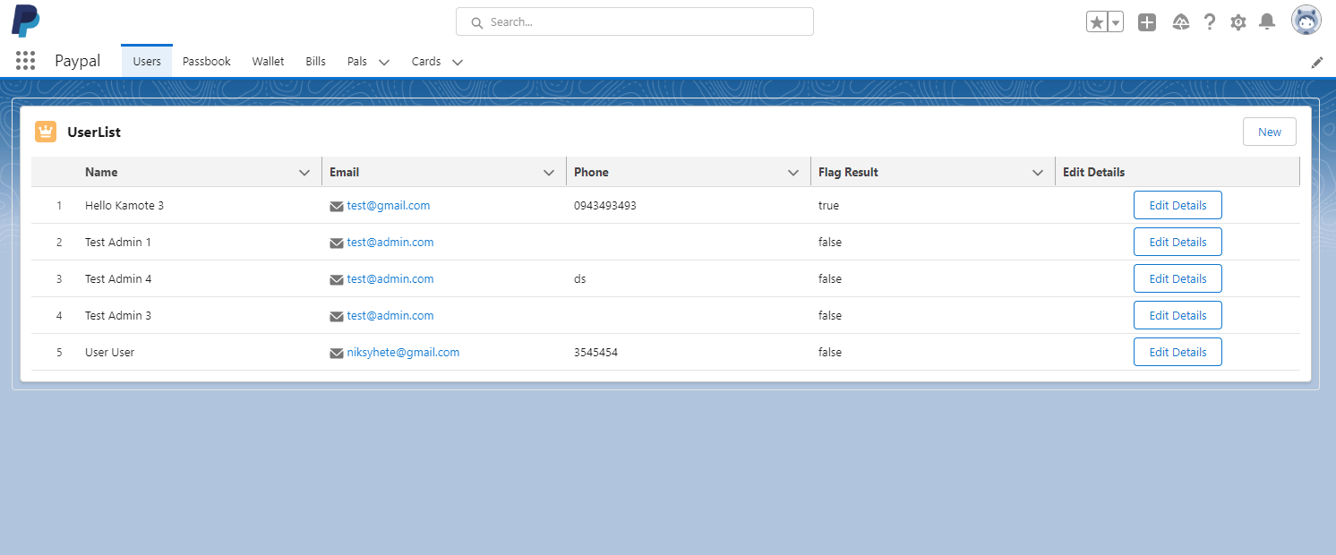
Admins View
Users Tab
Description: The Admins view can view all the registered users in a Users Custom Object. When you click the button Edit Details, you can see all details using modal and edit them. I'm using the apex class method to update the Users' details. From here, the admin can flag the user to stop or restrict their transactions.

Slide 4
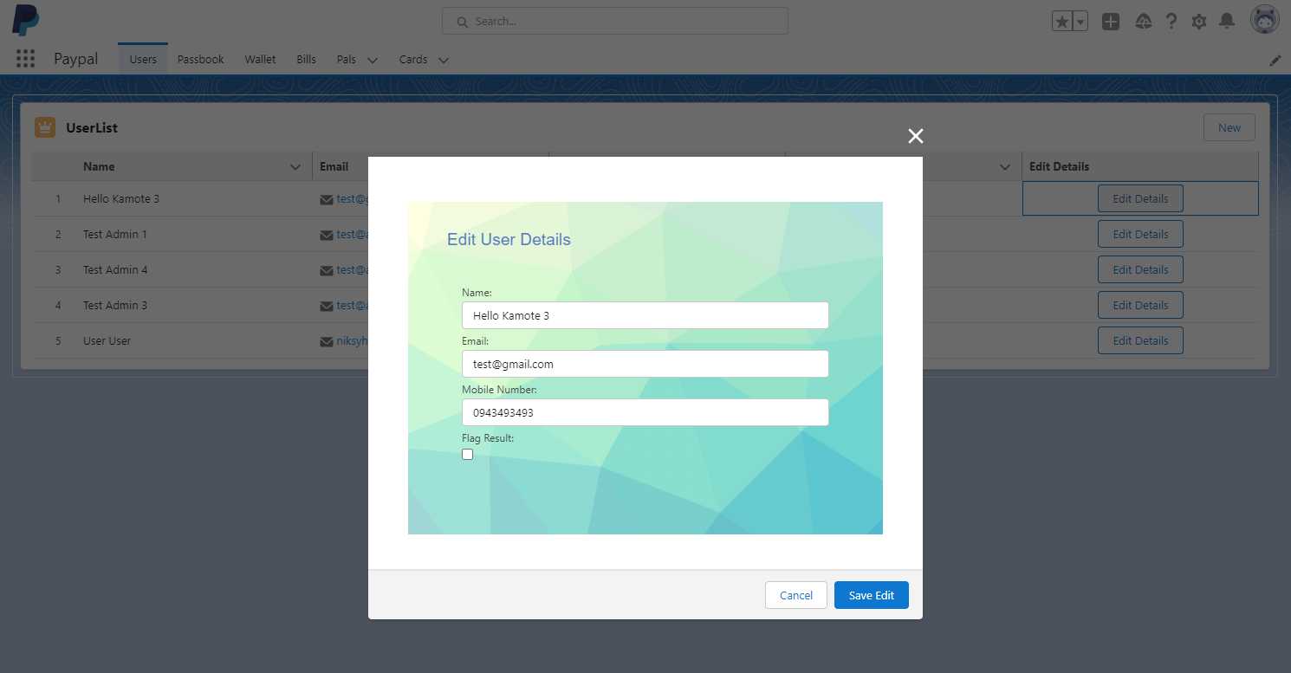
Admins View
Users Tab
Description: The Admins view can view all the registered users in a Users Custom Object. When you click the button Edit Details, you can see all details using modal and edit them. I'm using the apex class to update the Users' details. In here the admin can flag the user to stop or restrict their transactions

Slide 5
Support Teams View
Paypal App Clone
User Object

Slide 6
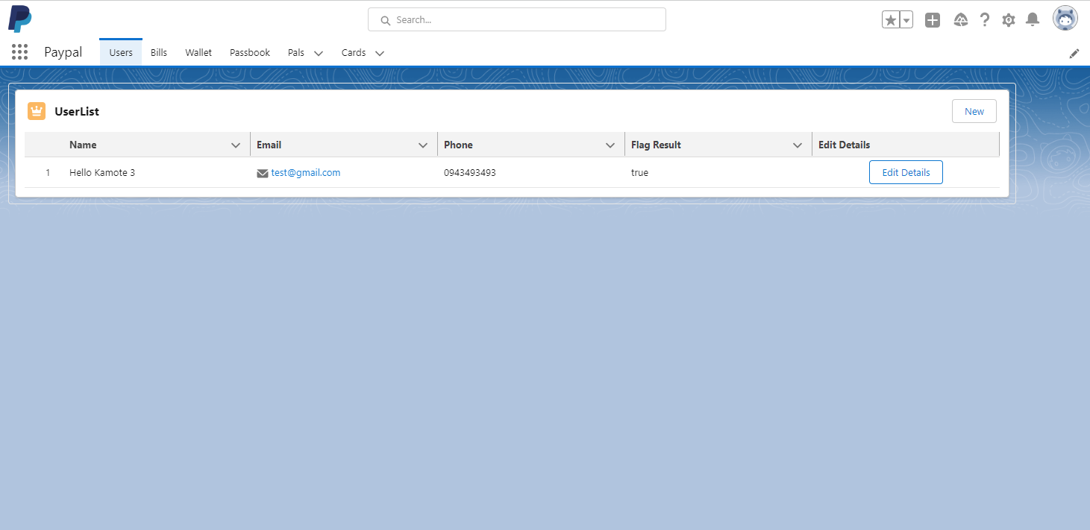
Support Teams View
Users Tab
Description: The Support Teams view can only view the registered users in a Users Custom Object but with a TRUE flag result which means the users that are in restricted mode. Support Teams are the people who will fix or review the users account. When you click the button Edit Details, you can see all details and edit them just like the admins permission. I'm using the apex class to update the Users' details.

Slide 7
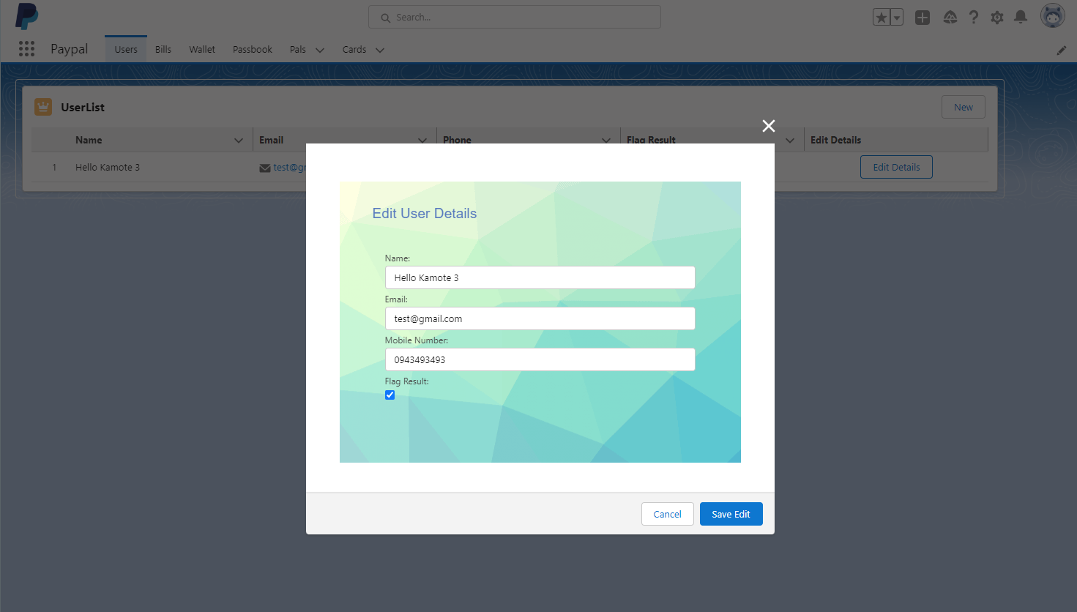
Support Teams View
Users Tab
Description: The Support Teams view can only view the registered users in a Users Custom Object but with a TRUE flag result which means the users that are in restricted mode. Support Teams are the people who will fix or review the users account. When you click the button Edit Details, you can see all details and edit them just like the admins permission. I'm using the apex class to update the Users' details.

Slide 8
Paypal Users View
Paypal App Clone
User Object

Slide 9
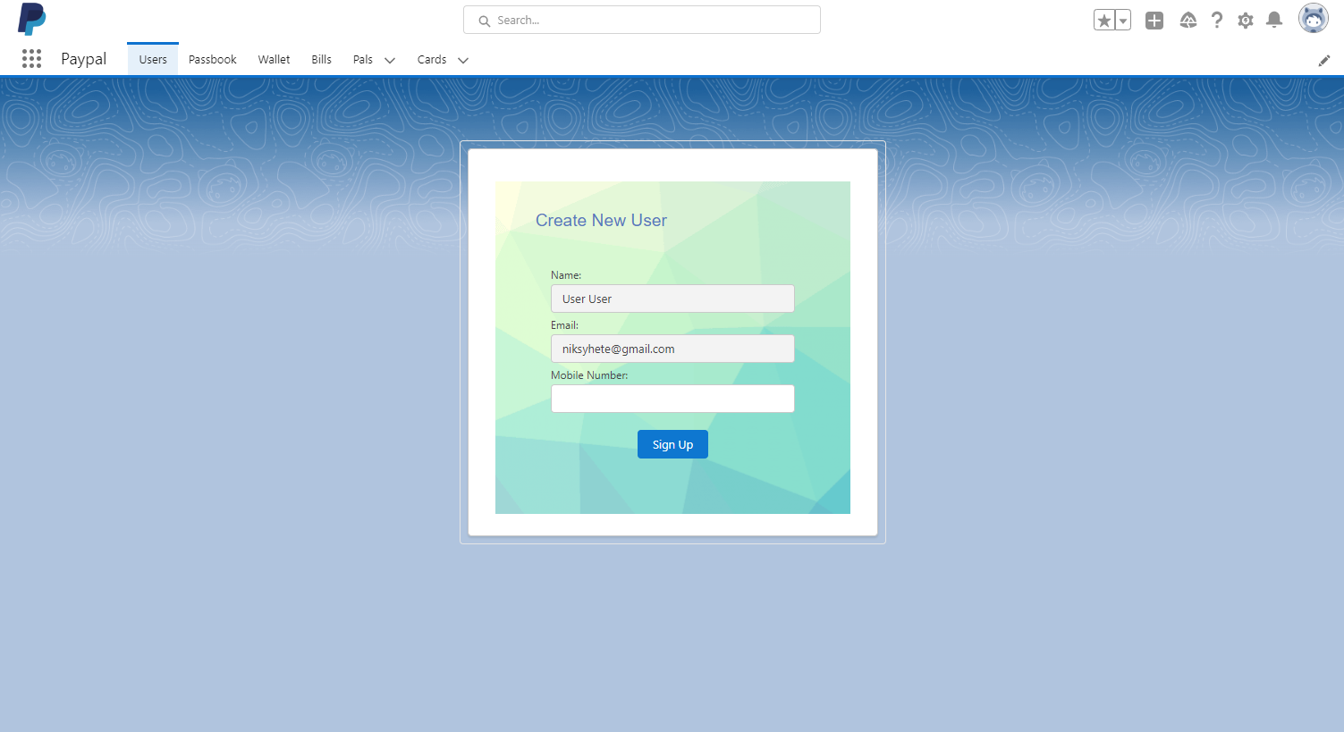
Users View
Users Tab
Description: As usual, a user can only create an account and is not able to see the back end. As per restrictions, users can only make one account. The Name and Email inputs are automatically populated with a duplicate rule where the users can not make more accounts with the same id or name.

Slide 10
Admins View
Paypal App Clone
Wallet Object

Slide 11
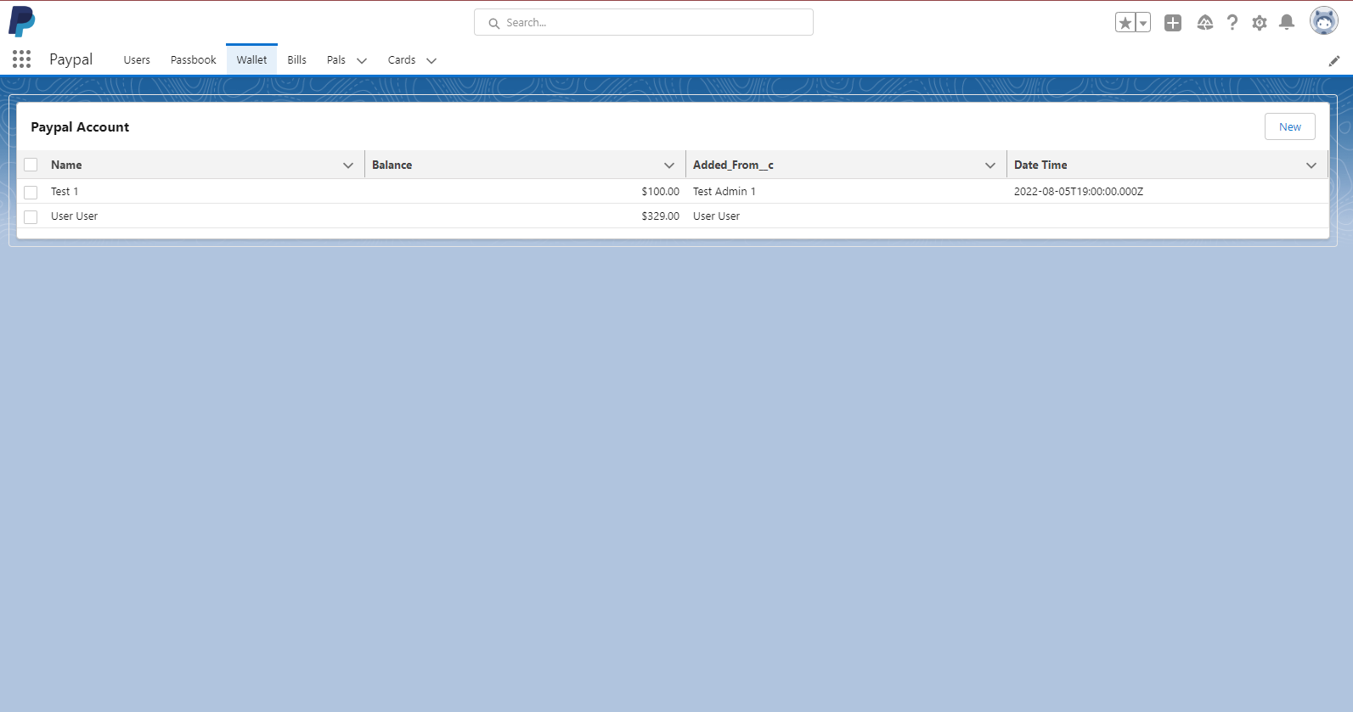
Admins View
Wallet Tab
Description: Admins can view all users wallet, they can create but can not edit.

Slide 12
Support Teams View
Paypal App Clone
Wallet Object

Slide 13
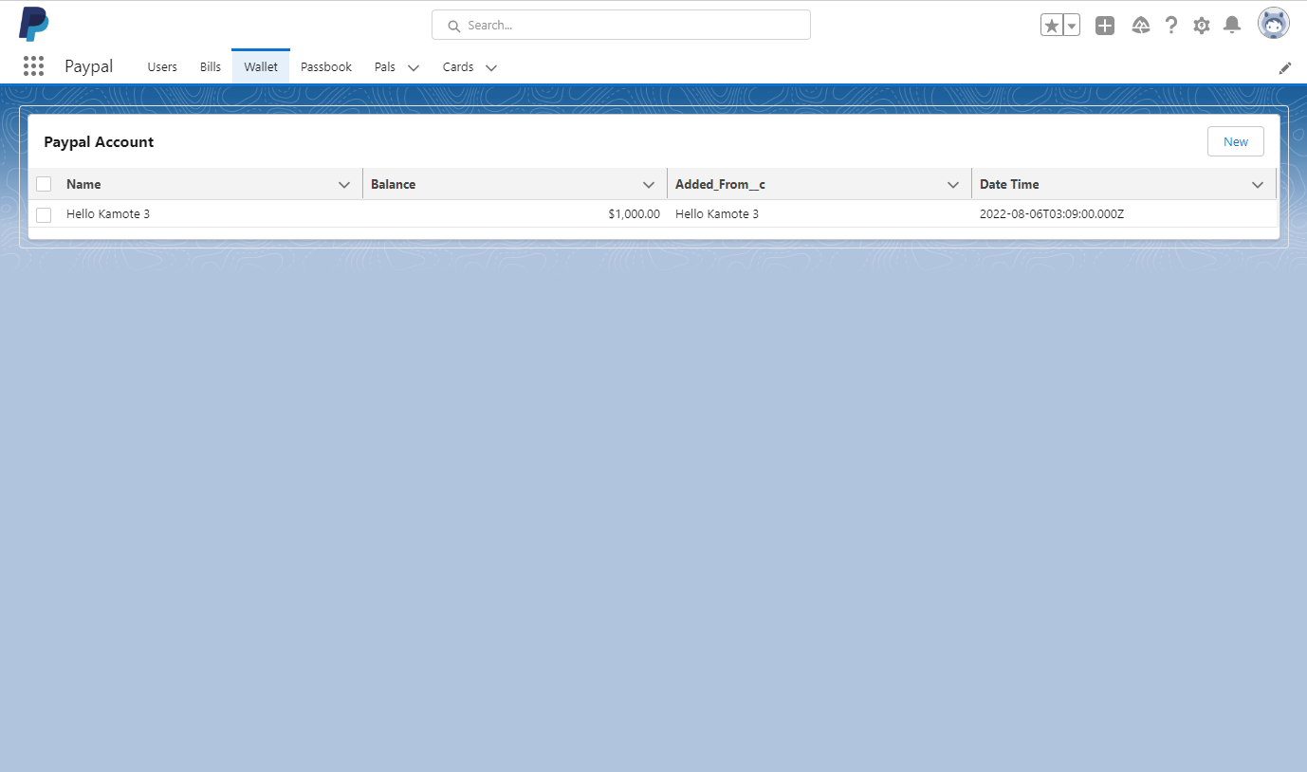
Support Teams View
Wallet Tab
Description: Admins can ony view all Flag account users account.

Slide 14
Paypal Users View
Paypal App Clone
Wallet Object

Slide 15
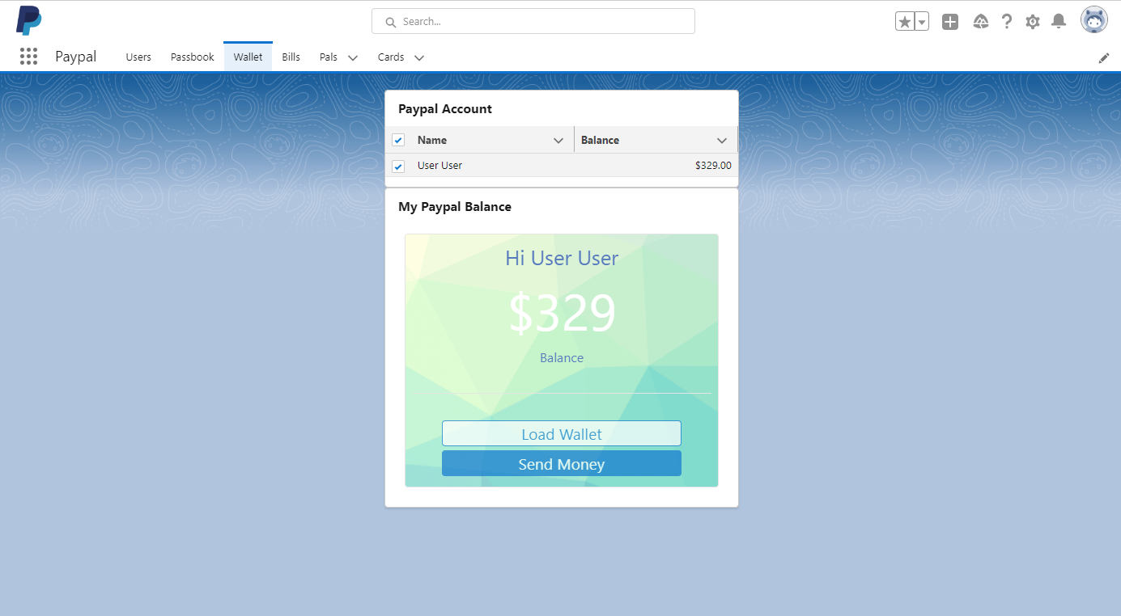
Users View
Wallet Tab
Description: Users can select their account, check their balance, and send money. As the Use case says, when you click the Load Wallet, there's a toast message that says 'insufficient balance' when the user tries to load the wallet. I set it randomly by using the Boolean function so I when I get a value of true then the Insufficient error will pop up and then if its false, then the Load Wallet will pop up. When you click the Send Money, you can send money to your family, friends and staff by searching their name.

Slide 16
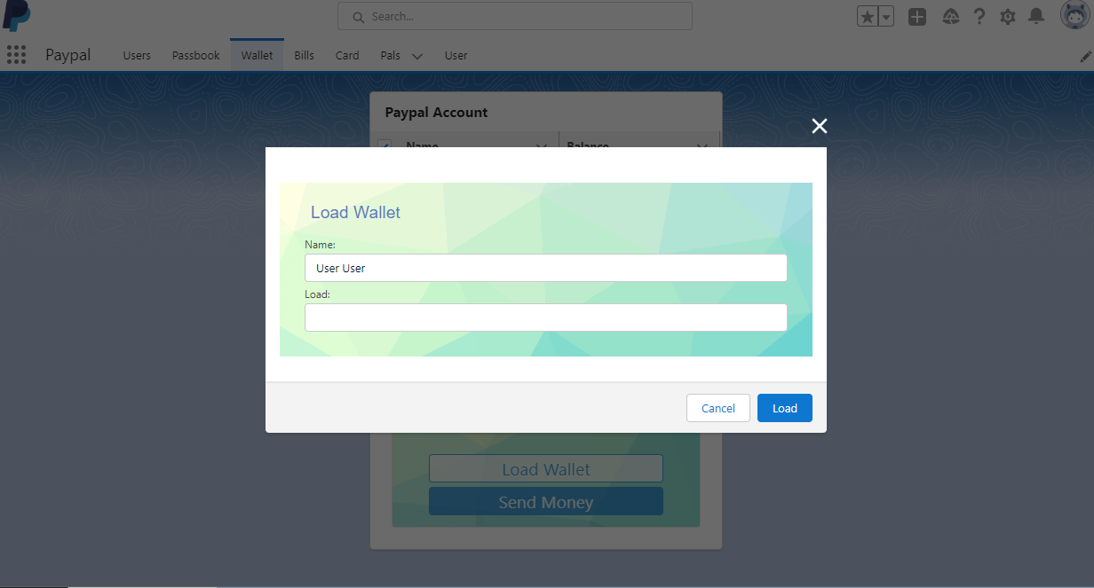
Users View
Wallet Tab
Description: Users can select their account, check their balance, and send money. As the Use case says, when you click the Load Wallet, there's a toast message that says 'insufficient balance' when the user tries to load the wallet. I set it randomly by using the Boolean function so I when I get a value of true then the Insufficient error will pop up and then if its false, then the Load Wallet will pop up

Slide 17
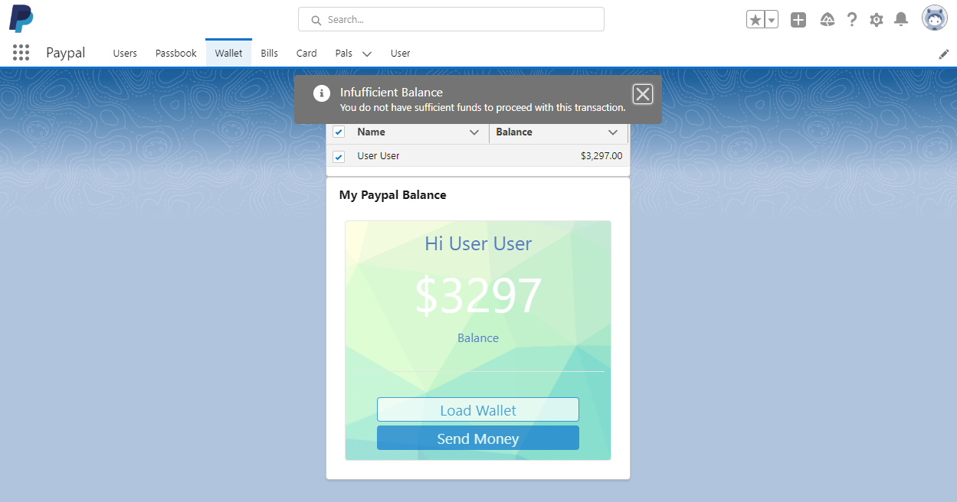
Users View
Wallet Tab
Description: Users can select their account, check their balance, and send money. As the Use case says, when you click the Load Wallet, there's a toast message that says 'insufficient balance' when the user tries to load the wallet. I set it randomly by using the Boolean function so I when I get a value of true then the Insufficient error will pop up and then if its false, then the Load Wallet will pop up

Slide 18
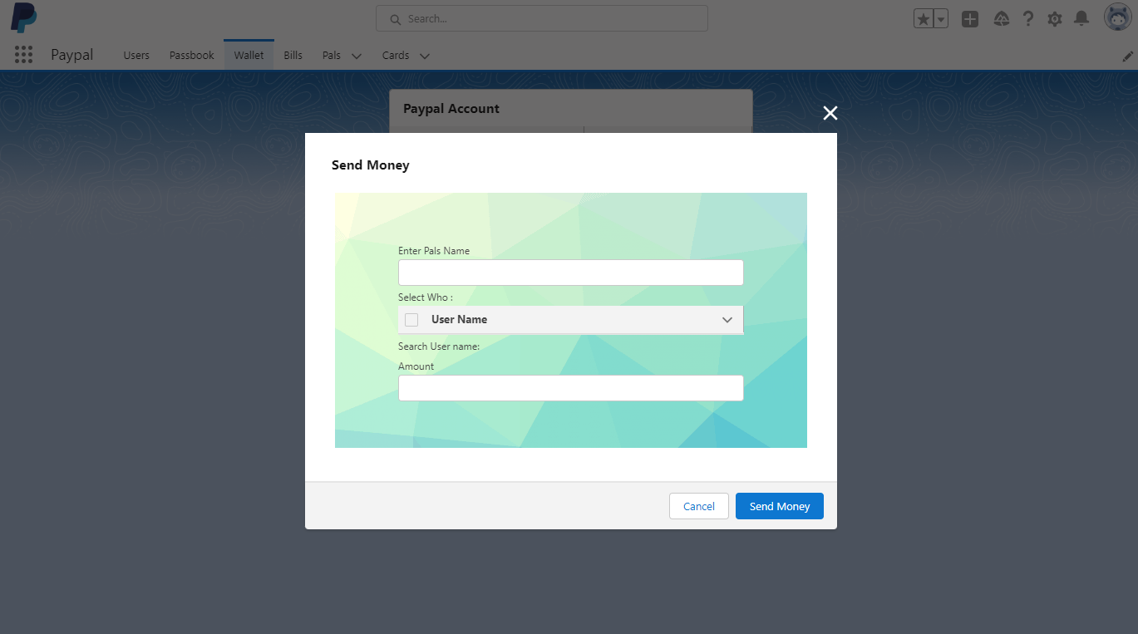
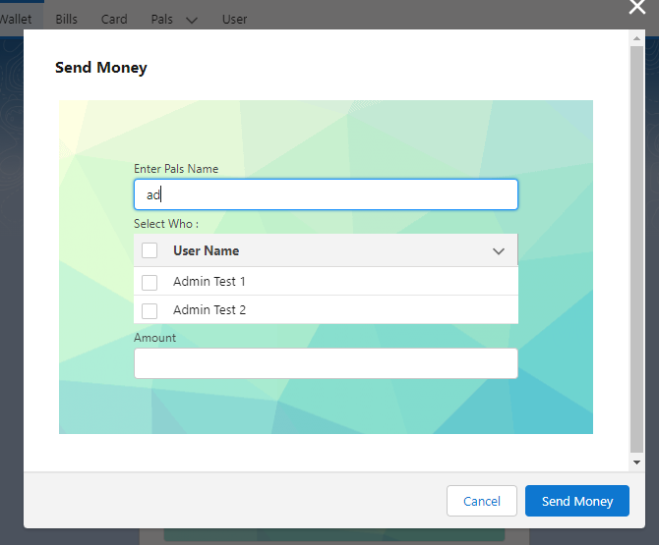
Users View
Wallet Tab
Description: The Use case for Pals also says that the user can search his/her pals and send money to it. I’m using apex for update both the receivers and senders. When the sender sends a money it will automatically deducted to his/her wallet. When the receiver receives a money, then it will be added to his/her current balance. When you click the Send Money, you can send money to your family, friends and staff by searching their name.

Slide 19
Admins View
Paypal App Clone
Bills Object

Slide 20
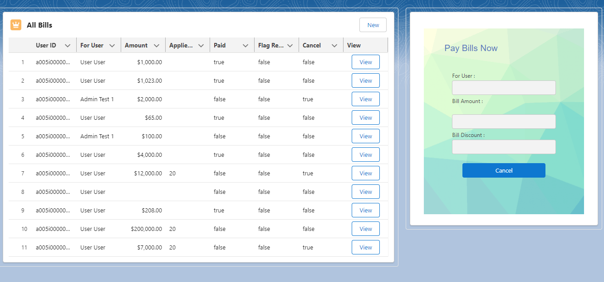
Admins View
Bills Tab
Description: Admin can view Paypal Bills of All Users ,can create New and can Cancel Transactions.

Slide 21
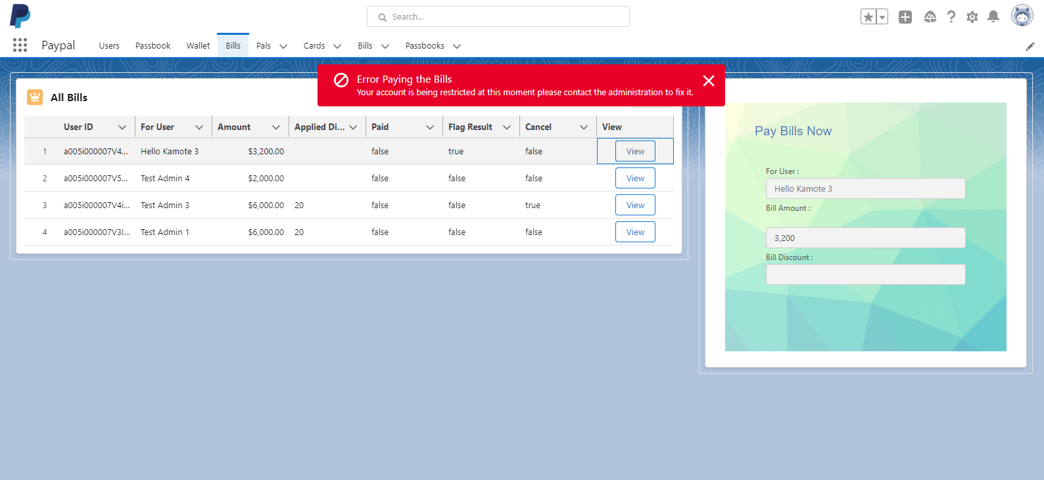
Admins View
Bills Tab
Description: If the account has been flag by the admin, meaning the account has been restricted in any transactions. The error will appear and the users can not proceed to any transactions.

Slide 22
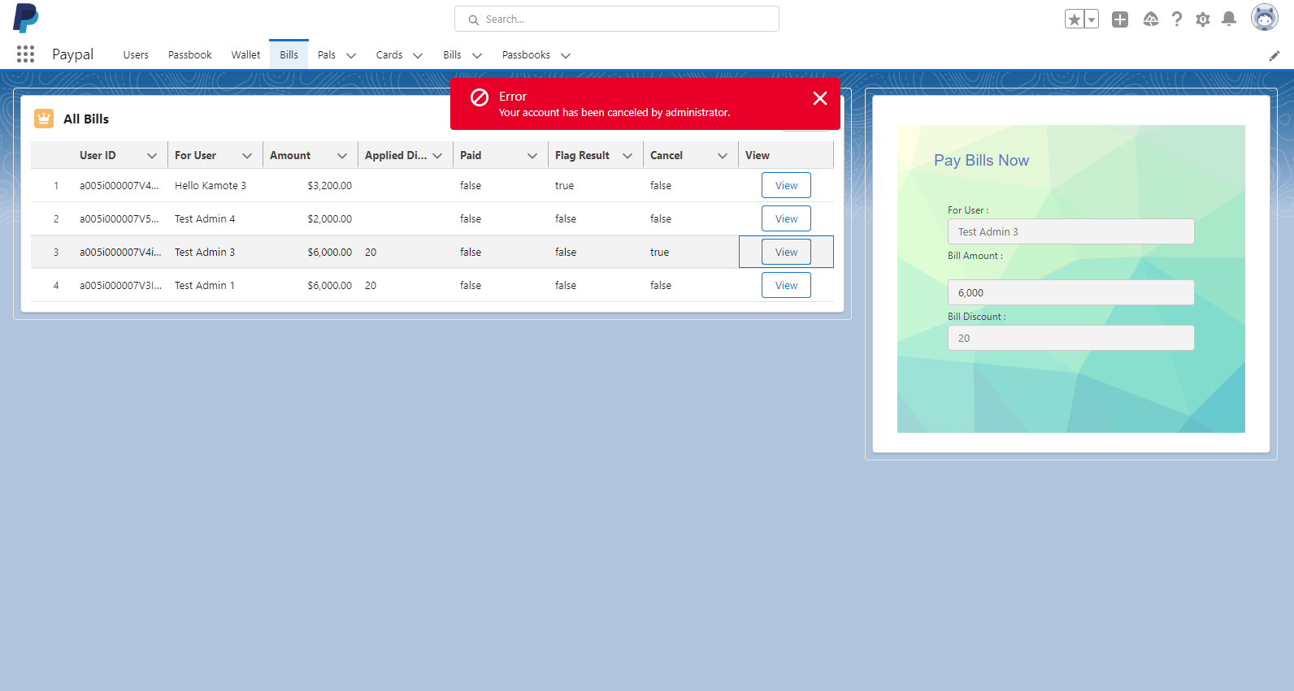
Admins View
Bills Tab
Description: If the Account has been canceled by administrator, the error will appear and will not proceed to the next transactions.

Slide 23
Support Teams View
Paypal App Clone
Bills Object

Slide 24
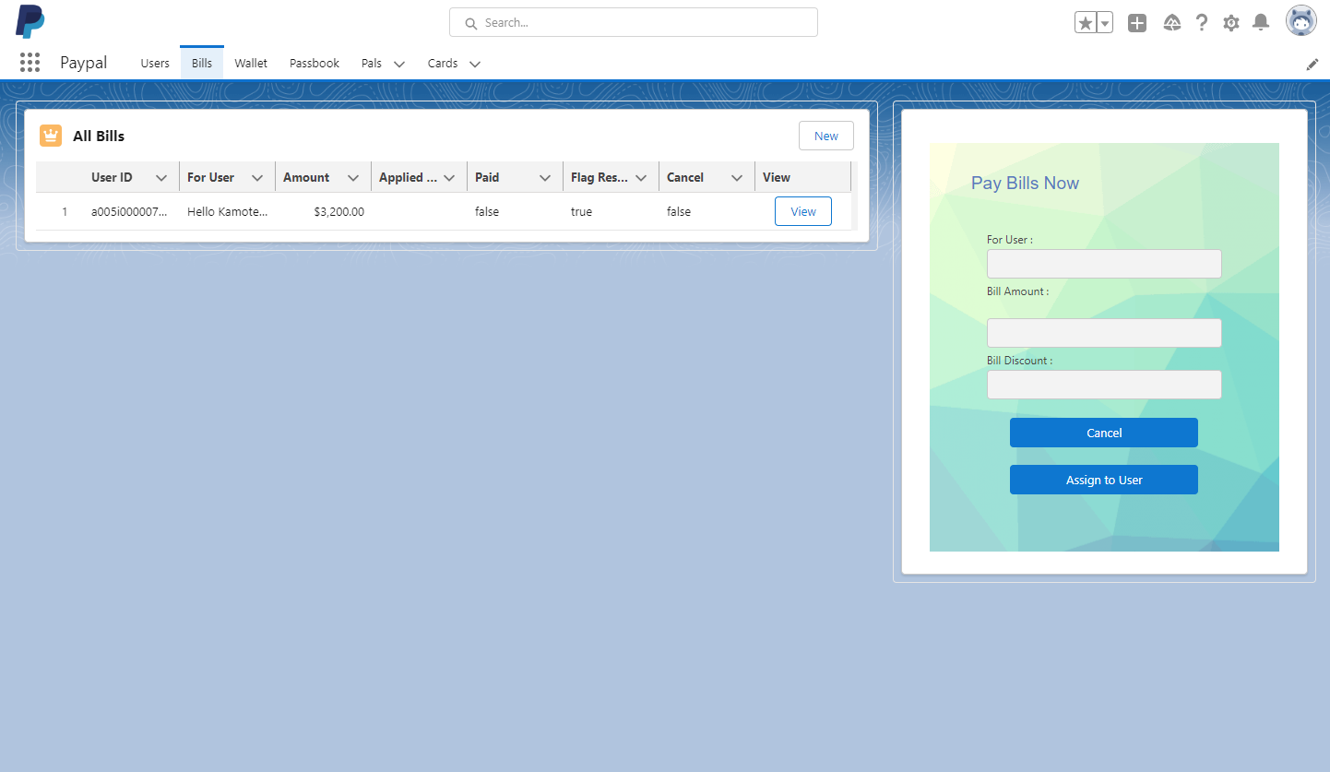
Support Teams View
Bills Tab
Description: Support teams can only view Flag account to review the account transactions.

Slide 25
Paypal Users View
Paypal App Clone
Bills Object

Slide 26
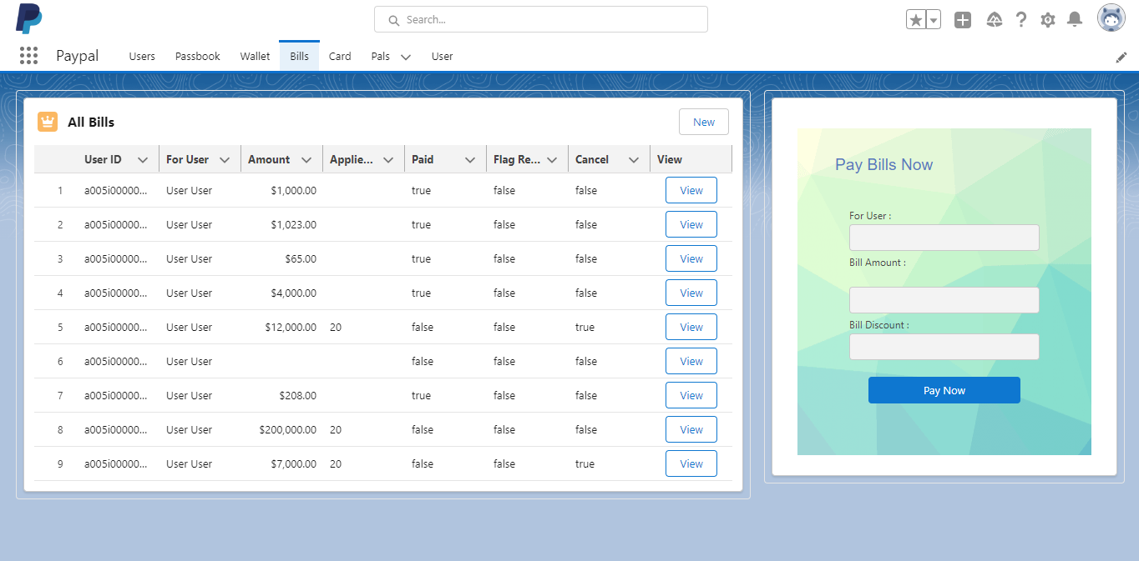
Users View
Bills Tab
Description: Users can see all their Bills. As the use case says that the users will only have an access to his/her transactions.

Slide 27
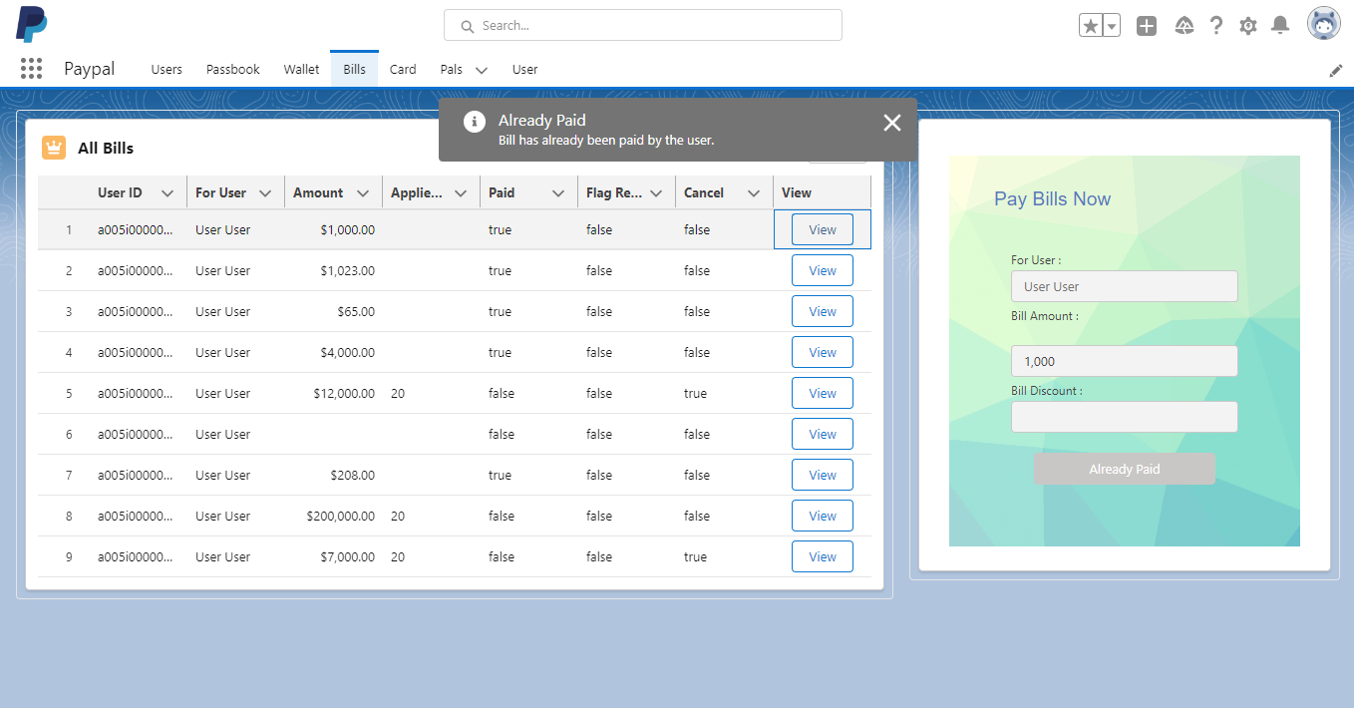
Users View
Bills Tab
Description: If the user bill transaction has been paid, the information toast will pop saying the bill has already been paid by the user.

Slide 28
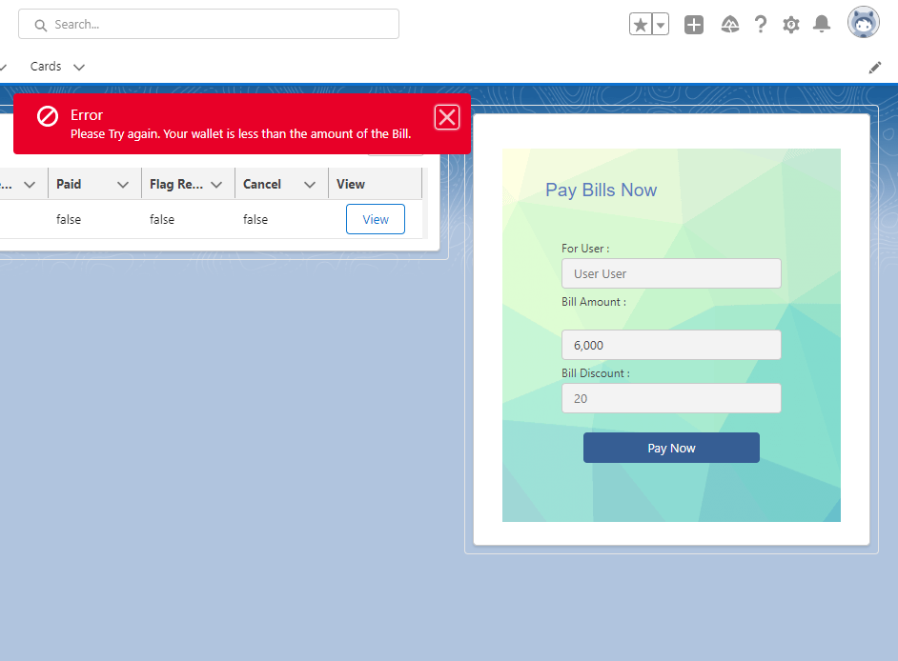
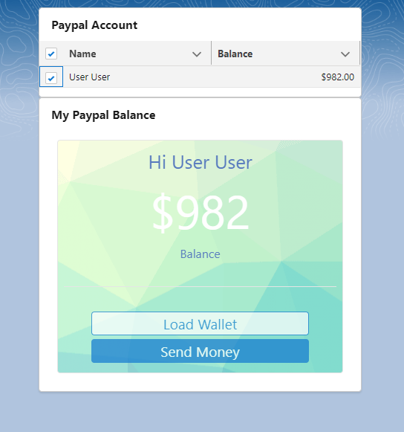
Users View
Bills Tab
Description: If the user tries to pay the bill, an error will show and the users view will navigate back to the wallet page.
Error Paying
Current Balance

Slide 29
Admins View
Paypal App Clone
Passbook Object

Slide 30
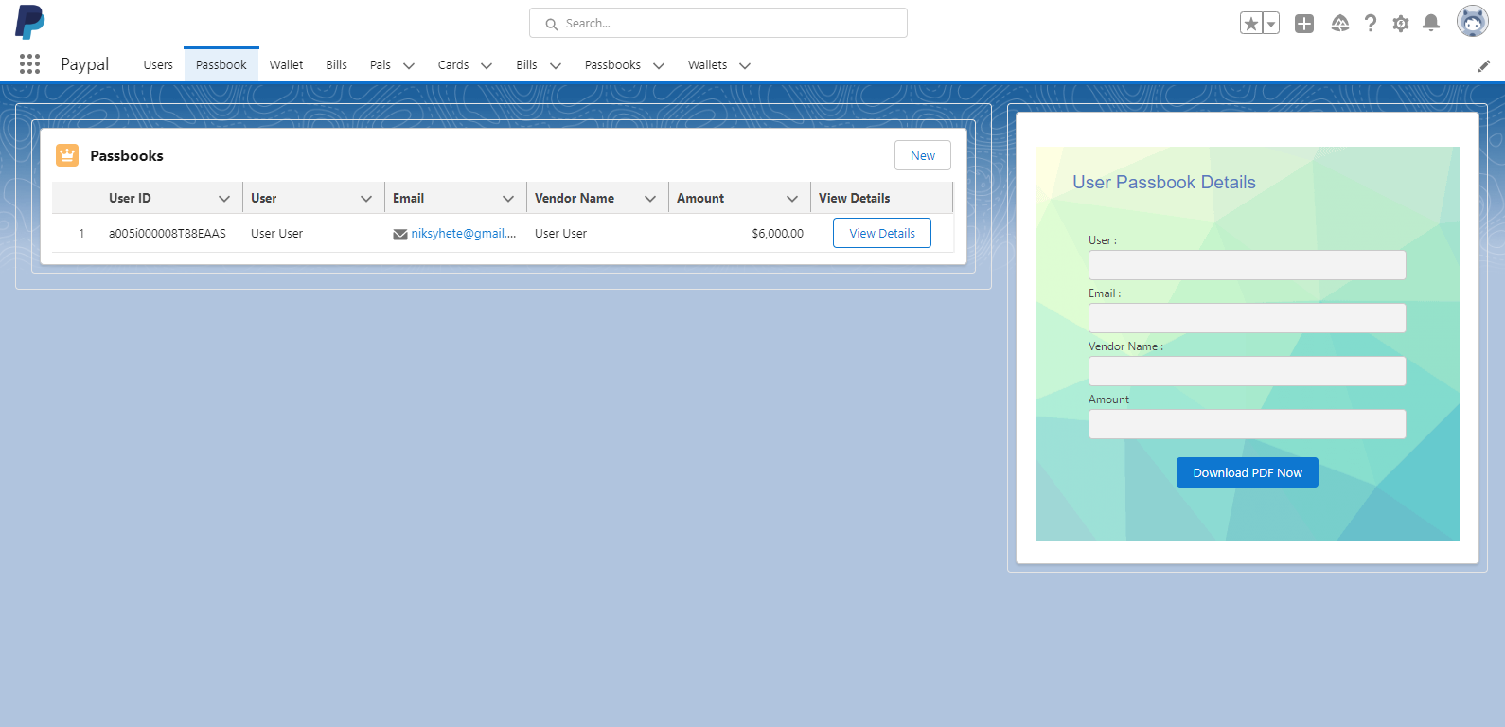
Admins View
Passbook Tab
Description: Admin can view all Passbook details of Users but can not have a Send Email Button.

Slide 31
Support Teams View
Paypal App Clone
Passbook Object

Slide 32
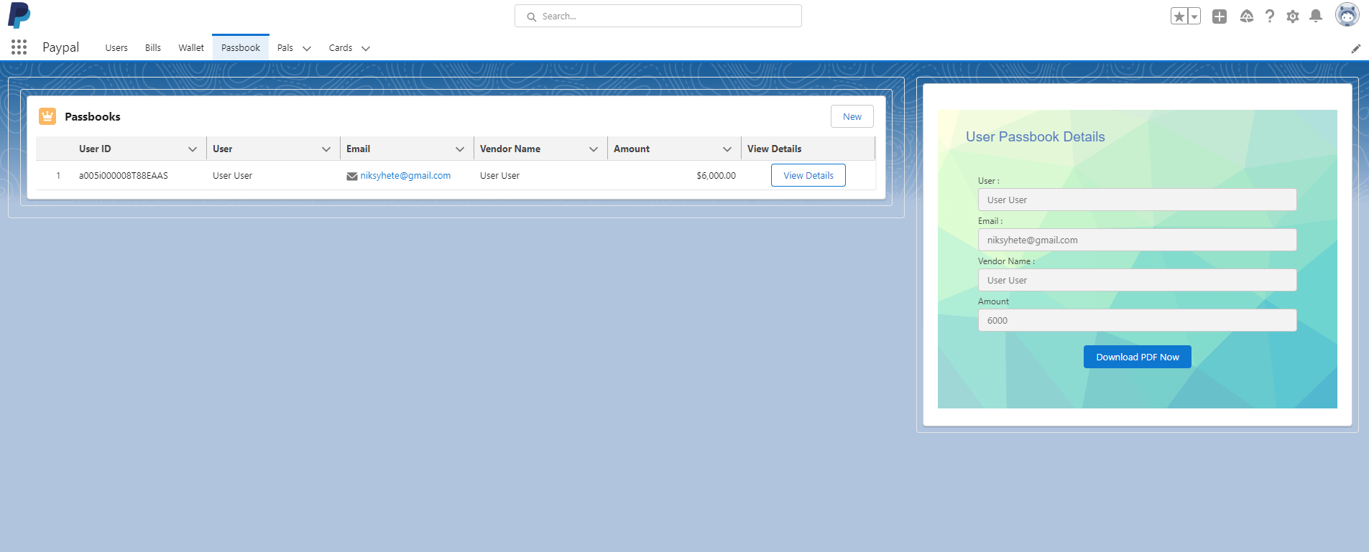
Suppor teams View
Passbook Tab
Description: The support teams may only see a transaction if the user has been flag by administrator.

Slide 33
Paypal Users View
Paypal App Clone
Passbook Object

Slide 34
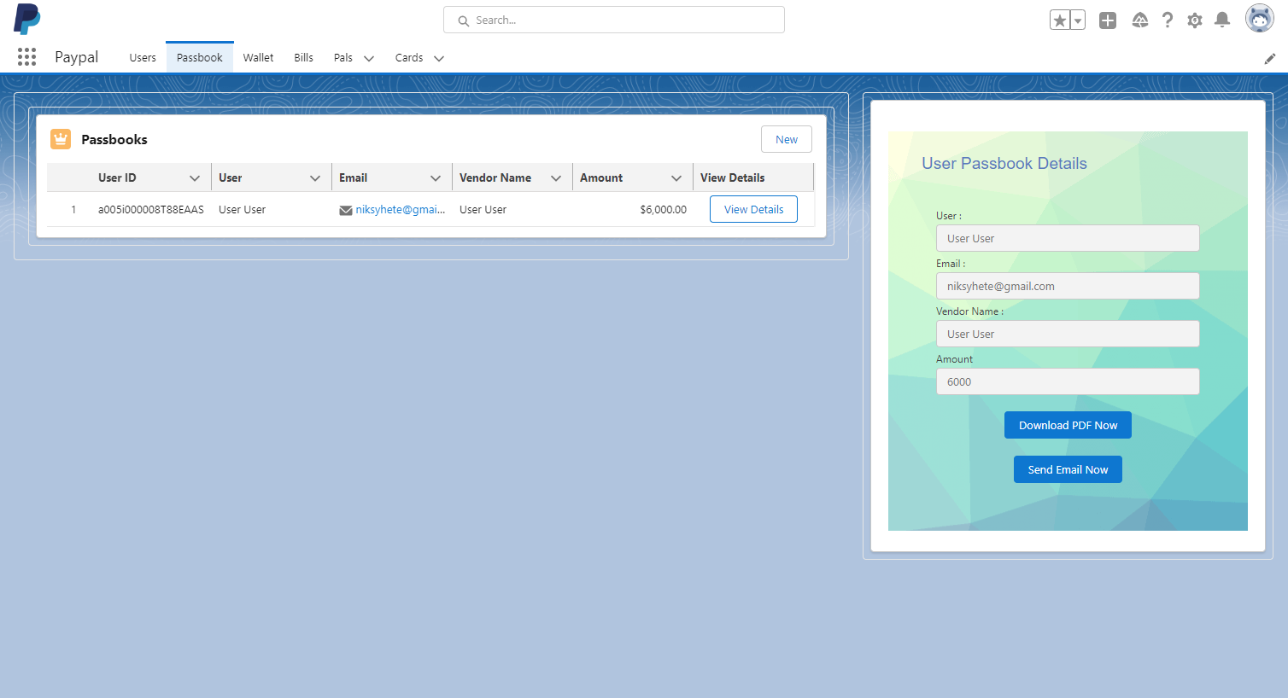
Users View
Passbook Tab
Description: After the users pays the Bills, the entry will be added in the Passbook where the user can send the email to himself/herself or Download it.

Slide 35
All types of users View
Paypal App Clone
Card Object

Slide 36
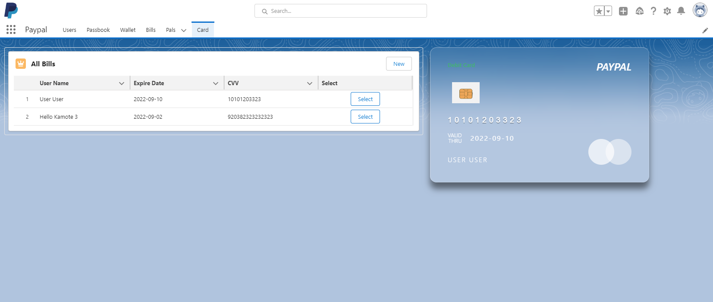
All types
Card Tab
Description: An admin can see all the users Card and can create one for the users. While the Users can see his/her own card and the Support team can only view the flag accounts card.

Slide 37
Thank you very much

Slide 38
My name is Juliet M. Nicanor

Slide 39
Here is what I did for this project
Creation of Custom Object
Setting FLS
Validation Rules
Creation of methods in Apex Class
Creation of Apex Trigger
Sharing Settings / Sharing Rules
LWC

Slide 40
…

